Slide 1
ENHANCED FEEDBACK LMS
Mariam Mohamed
20213571

Slide 2

Problem and goal (Why was this project developed?).
solving a common problem
share their complaints and suggestions
help students share their feedback and suggestions in a simple and effective way.

Slide 3
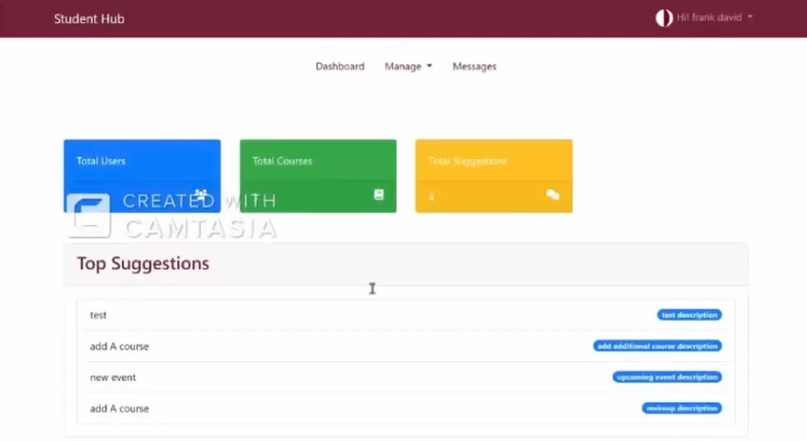
Admin dashboard

Slide 4
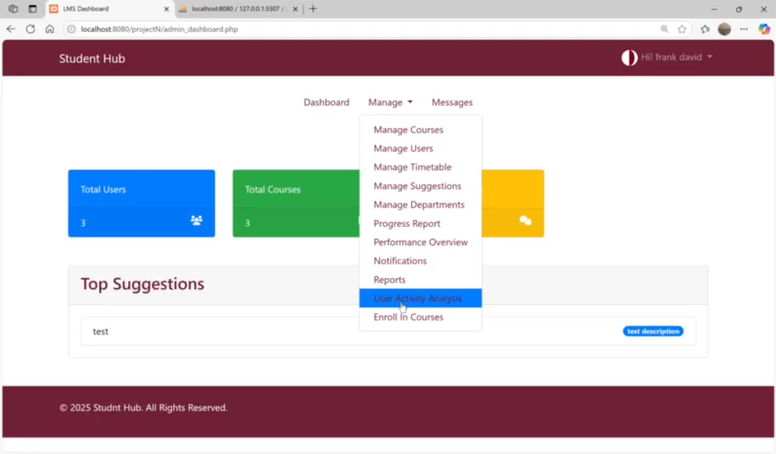
Frontend dashboards

Slide 5
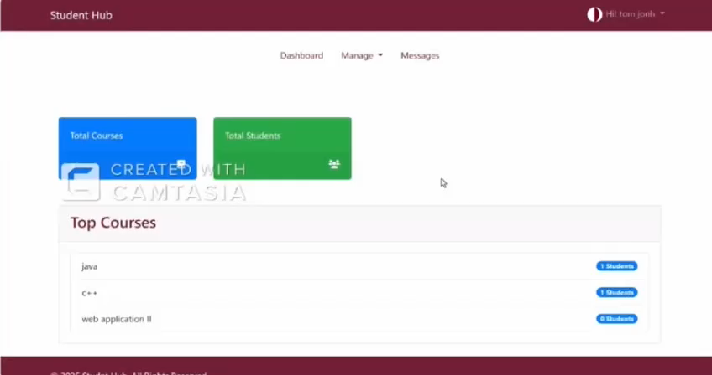
Instructor dashbard

Slide 6
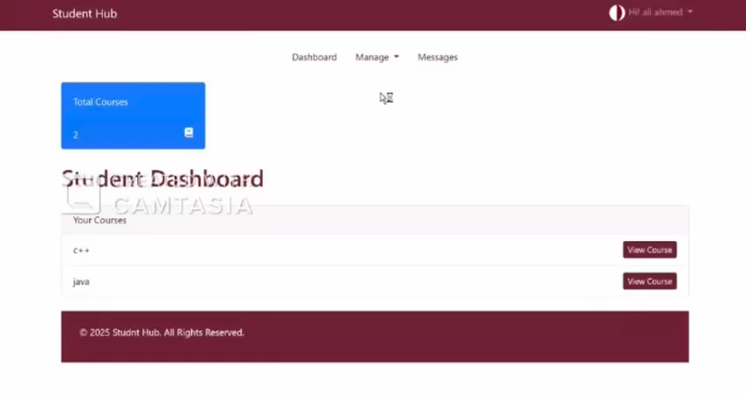
Student dashboard

Slide 7
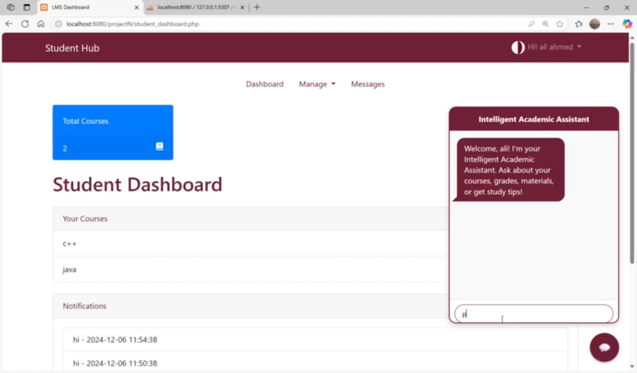

Slide 8
Thanks for listening!

